Slide 1
Southern Coalition Executive Committee Meeting
May 13, 2019
8:00 a.m. – 12:00 p.m.

Slide 2
Introductions and Roll Call

Slide 3
Minutes Review and Approval Treasurer’s Report and Approval

Slide 4
Breakdown of Budget for 2019-2020
HPP Staff- $120,440.00
HPP Travel- $22,271.00
HPP Supplies- $347.00
HPP Support- $1,000.00
DPHHS Indirect Costs- $45,345.00
MHA Staff- $374,071.00
MHA Indirect Costs- $162,812.00
MHA Support- $27,073.00
MHA Travel- $72,148.00
Each Coalition- $66,217.50 (x 4)
Total - $1,090,377.00

Slide 5
Determine Budget for 2019-2020
Budget: $66,217.50
Juvare Payment: $61,535.10(total)
$15,383.77 per coalition
ABLS (Advanced Burn Life Support)
$10,500.00 per class
typically hosted in each region
25 students
4 year certificate
BDLS (Basic Disaster Life Support)
$5,350.00 (Approx. per class includes books)
Approx. $1,337.50 per coalition depending on how many classes

Slide 6
Budget (cont.)
ADLS (Advanced Disaster Life Support)
Class and venue approx. $43,000.00 (Class $37,000.00; Venue $6,000.00)
50 students
3 year certificate
Approx. $10,750.00 per coalition
CHEC (Certified Hospital Emergency Coordinator)
$18,000.00 per class
Hosted regionally this year
25-30 students
3 year certification (if certified)

Slide 7
Grant Applications
St. Vincent Health Care
Grant Amount- $70,000.00
Cost Match- $83,709.84
Determine amount to fund after review of the budget.

Slide 8
Old Business

Slide 9
Southern coalition Executive Committee
First Name | Last Name | Title | Company | Email
Bill | Hodges | Treasurer/ Emergency Prpeparedness | Big Horn Hospital Association | BHodges@bighornhospital.org
Rob | Farnum | Co-Chair Emergency Preparedness | Pioneer Medical Center | rfarnum@pmcmt.org
Charles | Hanson | DES | MT DES | CHHanson@mt.gov
Jen | Staton | Public Health | RiverStone Health (Public Health) | jennifer.sta@riverstonehealth.org
Jason | Mahoney | Chairperson | AMR / EMSC | medic373@gmail.com
Stephen | Schmid | Life Flight | Life Flight Network | sschmid@lifeflight.org
Greg | Coleman | Director | Park County OEM | GColeman@parkcounty.org
Sue | Woods | Public Health Emergency Prepardness | CMHD | phn@co.fergus.mt.us
Dave | Nordel | Emergency Preparedness | St. Vincent Hospital | david.nordel@sclhealth.org
Birgen | Knoff | System Director, Clinical Practice, R.N. | Bozeman Health | bknoff@bozemanhealth.org
Don | McGiboney | Emergency Preparedness | DPHHS | DMcGiboney@mt.gov
Kevin | O'Loughlin | DPHHS | DPHHS PHEP | koloughlin@mt.gov
Bryan | Tavary | Healthcare Preparedness Program Coordinator (ABLS) | DPHHS | bryan.tavary@mt.gov
Cindee | McKee | Secretary/ Emergency Preparedness Coord. | MHA | cindee.mckee@mtha.org
Scott | Rainey | Vitalant (United Blood Services) |  | Srainey@vitalant.org
Nathan | Moyer | Emergency Preparedness | Lame Deer | nathan.moyer@ihs.gov

Slide 10
Election of New Officers
Chairman (co-chair moves up)
Volunteers/Discussion, election of co-chair
Volunteers/Discussion, election of treasurer
Volunteers/Discussion, election of secretary

Slide 11
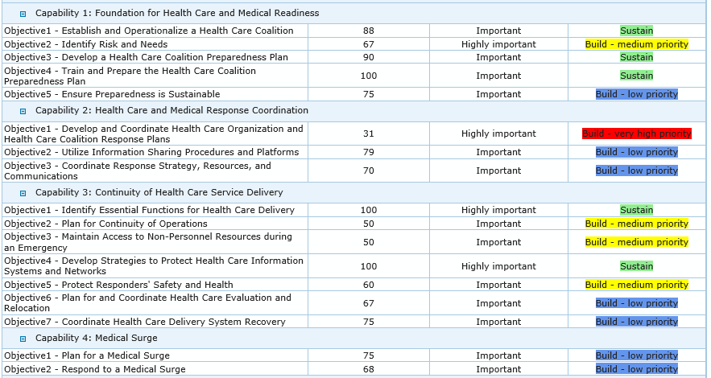
Southern Coalition Assessment Tool

Slide 12
New Business

Slide 13
HPP FOA review of requirements
Healthcare Readiness and Response Coordinator:
Volunteer to be on the interview panel
Clinical Advisor:
Volunteer/suggestions

Slide 14
Review of Additional HCC Membership
The four core members of HCCs will remain the same. However, HPP encourages additional representation from these functional entities that are required to support acute health care service delivery. These are not limited to the following:
Medical supply chain organizations
Pharmacies
Blood banks
Clinical labs
Federal health care organizations
Outpatient care centers

Slide 15
New Business (continued)
Southern Coalition New Name
Southern Coalition Logo
Would you like to use this?

Slide 16
New Business (Continued)
Juvare Presentation
Kyrsten
Advisory Council Update
Don

Slide 17
Southern Coalition Juvare Update
Contacted all facilities at least 3 times if no response to initial email was received, which was 2 facilities
Met with 9 facilities- all hospitals or critical access hospitals, 17 individuals trained
1 county DES agency received training,
eICS was used for 1 real event, and 3 drills in the coalition

Slide 18
Southern Coalition Juvare Update
CHEERS
3 facilities very enthusiastic regarding the software- already uploading EOPs, contacts, etc
County agencies very enthusiastic about access to eICS
Excited about the ‘mass notification’ feature
Many ideas for utilizing EMResource for inventory management

Slide 19
Southern Coalition Juvare Update
CONCERNS
regarding the front-end work needed to load the information into the software program
keeping contact lists up to date
repeated training of staff on the software

Slide 20
Other Possible trainings for 2019-2020
Mental Health First Aid for EMS/Law Enforcement/Fire
Summer Institute
Place holder for all 4 coalitions to come together for an annual meeting
Pediatric Disaster and Emergency Preparedness
Health Sector Emergency Preparedness (HSEP)

Slide 21
Upcoming educational opportunities
CISM Training (Group Crisis Intervention Training:
June 6th & 7th Helena (approve mileage and lodging)
CHEC (Certified Hospital Emergency Coordinator):
June 10th, 11th, and 12th Great Falls (approve mileage and lodging)
TEEX Exercise & Training- Active Shooter:
June 25th Great Falls (approve mileage and lodging)

Slide 22
Upcoming Educational opportunities
Summer Institute:
July 16th -18th Missoula
July 16th 1:00-5:00 EC
July 17th 8:00 -5:00 EC
July 18th Health Sector Emergency Preparedness (HSEP)
Approve lodging and mileage for all 3 days
Pediatric Disaster Response and Emergency Preparedness Training:
August 7th & 8th Great Falls
Approve mileage and lodging for 2 -3 days

Slide 23
Upcoming Exercise Opportunities
Tragic School Bus 2
Pediatric Table Top Exercise
April 25th – May 30th
MCM October 2019
Looking for volunteers to be patients?
Volunteer Facilities?

Slide 24
Future Business Meeting
Bylaws
Regional HVA

Slide 25
Summer Institute All 4 Executive Committee Members
July 16th & 17th
July 18th HSEP (if you would like to stay and attend)
Topics

Slide 26
Contact Information
Don McGiboney
406-444-5942
DMcGiboney@mt.gov
Cindee McKee
406-457-8027
Cindee.mckee@mtha.org
Bryan Tavary
406-444-3898
Bryan.Tavary@mt.gov

Slide 27
Thank You!
Questions/ Comments/Thoughts

