Slide 1
Central Region Healthcare Coalition Executive Committee Meeting
June 8, 2023
9:30 A.M. – 2:30 p.M.
Great Falls Clinic Hospital-Specialty Room
VIRTUAL Option - Zoom

Slide 2
Introduction
Call To Order
Roll Call

Slide 3
Executive Committee

Slide 4
Executive Committee Representation
Executive committee voting membership - 7
(1) EMS Representative…Molly Carey
(1) Emergency Management Representative…Debbie Gessaman
(1) Public Health…Bridget Kallenberger
(1) Hospital Representative…Chris Lee
(1) Critical Access Hospital Representative…Josh Simonds
(1) ESF8 Partner at-Large…Brett Lloyd
(1) ESF8 Partner at Large…Alice Luehr

Slide 5
Guest Members

Slide 6
Minutes - Review & Approve
February 16th Executive Committee Meeting
Needs motion

Slide 7
Treasury Report
Current Budget – Review & Approval all remaining funds
Trainings
Virtual Vote: Approved – (2) ADVANCED BURN LIFE SUPPORT (ABLS) Classes
July 13th – Shelby 8:00 – 5:00
July 14th – Great Falls Clinic Hospital 8:00 – 5:00
Approved – 1 additional SIM-MT Training – Logan Health Cutbank
Approved – Remaining funds to be used for A.V.E.R.T.
Rescind the money allocated to the A.V.E.R.T.???

Slide 8
Central Healthcare Coalition Budget 2022-2023

Slide 9
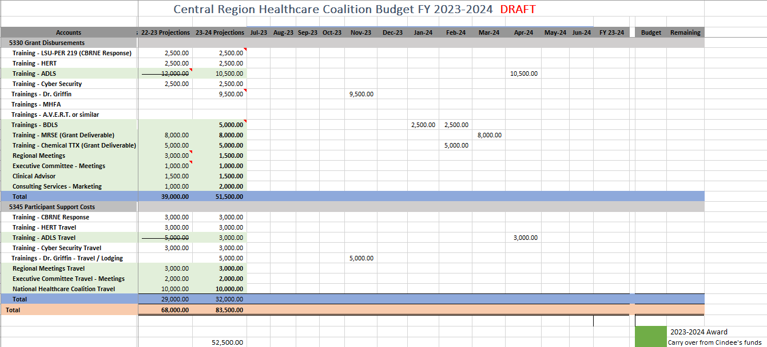
Central Healthcare Coalition Budget 2023-2024

Slide 10
Old Business
Simulation in motion (sim MT) Certified Healthcare Emergency Coordinator Course (CHEC)

Slide 11
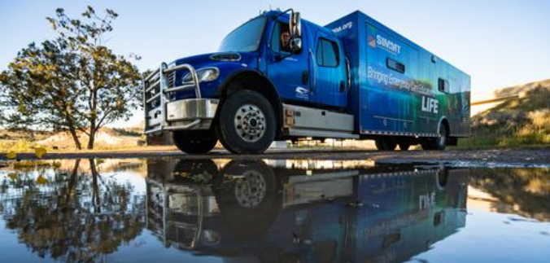
Old Business
FY 2020-21 and FY 2021-2022 COVID & HPP Carry Over Funds – $53,923.75
SIM-MT:
Provide a one-day training, using one sim lab truck, complete with time for simulation scenarios and a table talk discussion between departments.
Cost - One-day event using One simulation lab truck is $4,500.00
Best fit for a region with fewer than 18 participants
DETAILS:
SIM scenarios will take place in the morning of each day.
SIM-MT will facilitate a table top discussion between all divisions and participants in the afternoon.
Scenarios will be based off of an infectious disease, following the topics chosen by each coalition.
Training allows for regions to use their existing protocols. Ideally, the simulation scenarios would take pace in a region’s own facilities (ER, ambulance, etc) so participants can practice with the highest level of realism. SIM-MT will work with each region’s coalition director to determine the best option for their events.
The Coalitions will provide lunch, coffee and snack in the afternoon. Travel reimbursement if requested.

Slide 12
Old Business
Expected participants:
Hospital infectious disease team,
EMS,
local Public Health,
local DES,
Long Term Care
Any additional resources identified in your community
The Intent of this exercise is to bring local & regional partners together to strengthen communication and response to an infectious disease outbreak.
High-fidelity simulation to include transferring an infected patient from a congregate living facility via EMS to a healthcare facility.
Objectives:
Identification & use of appropriate PPE
Proper identification and initial treatment protocols for a highly infectious disease
TTX – communication channels
Roles in infectious disease outbreaks
How communications can be streamlined and improved

Slide 13
SIM-MT
Trainings Completed:
Benefis Teton Medical Center – 12/13/2022
Billings Clinic Broadwater – 01/12/2023
Mountainview Medical Center – 01/18/2023
St. Peters Hospital – 01/31/2023
Northern Montana Hospital – 02/01/2023
Missouri River Medical Center – 03/14/2023
Logan Health Chester – 04/04/2023
Logan Health Shelby – 04/11/2023
Logan Health Conrad – 04/18/2023
Logan Health Cutbank – 05/10/2023
Scheduled Trainings:
Great Falls Clinic Hospital – 07/19/2024

Slide 14
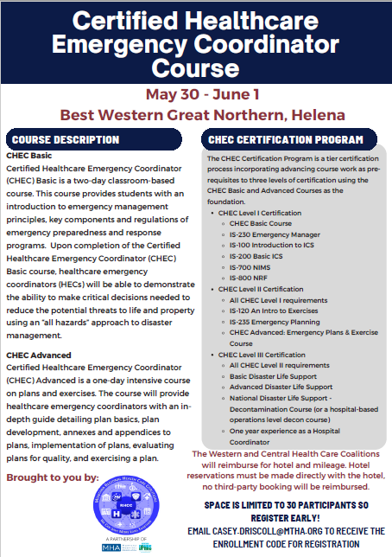
Certified Healthcare Emergency Coordinator Course

Slide 15
New Business
Radiation Annex (Grant deliverable) - Approved
Presenters:
Susanne Hill – Simulation in Motion Montana (SIM-MT)
Colin Campbell – Cascade County Public Health
Kim Newman – Montana Laboratory Services Bureau

Slide 16
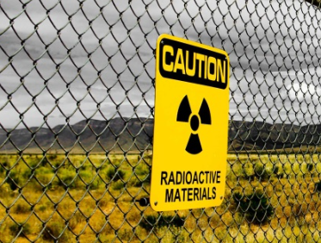
Radiation Annex

Slide 17
Simulation in Motion Montana
Susanne Hill – Sales Director

Slide 18
Colin Campbell Emergency planner Cascade County Health Department

Slide 19
Kimberly Newman, MS, M (ASCP CM) Laboratory Preparedness Specialist Department of Public Health & Human Services Montana Laboratory Services Bureau

Slide 20
Upcoming Trainings/Education/Events
Advance Burn Life Support:
July 13, Logan Health Shelby 8:00-5:00
July 14, Great Falls Clinic Hospital 8:00-5:00
SIM-MT – Great Falls Clinic Hospital – July 19th
Working on bringing in Burn Webinars once a month – Rebecca @ Swedish Medical Center
Working on options to provide JUVARE training for EMResource and eICS platforms.

Slide 21
Coordinator Update
SIM-MT – 11 facilities, 10 completed
MRSE – February 22nd – Grant Requirement
Facility site visits – 21
Reviewing & updating access rights in EMResource
Coordinators in person meeting in Havre April 5-6
Monthly Coalition Newsletter Publication –
Weekly Coordinator Zoom Calls- work on work plans, budgets, upcoming events, trainings, annexes, AAR/IP’s, etc.
Radiation Surge Annex (Final Draft) - Grant Requirement
Attending LEPC meetings, continue to obtain dates and times of meeting in the Central Region
Attending Hospital Emergency Preparedness Meetings
Resource and Gap Analysis – Grant Requirement
ASPR TRACIE tool (excel spreadsheet)
Specific to each facility/agency type (Hospitals, EMS, Public Health, LTC, Outpatient)
Assessment to identify health care resources & services that are vital for the continuity of health care delivery during & after an emergency
Provide a common understanding of resources & existing gaps as well as prioritizing activities to close gaps.
Central Regional PHEP meeting – Great Falls May 10th
Central Regional HPP Regional meeting – Great Falls May 11th
Coordinator Update
Incident Command Training
Visited Dispatch Center at Logan Health Kalispell
NorthWest Energy - Ryan Dam Site Visit, TTX, Functional Exercise
CHEC Course

Slide 22
Central Coalition Readiness and Response Coordinator
Please send any information pertaining to training and exercises in your area to me at kitty.songer@mtha.org
406-465-4484

Slide 23
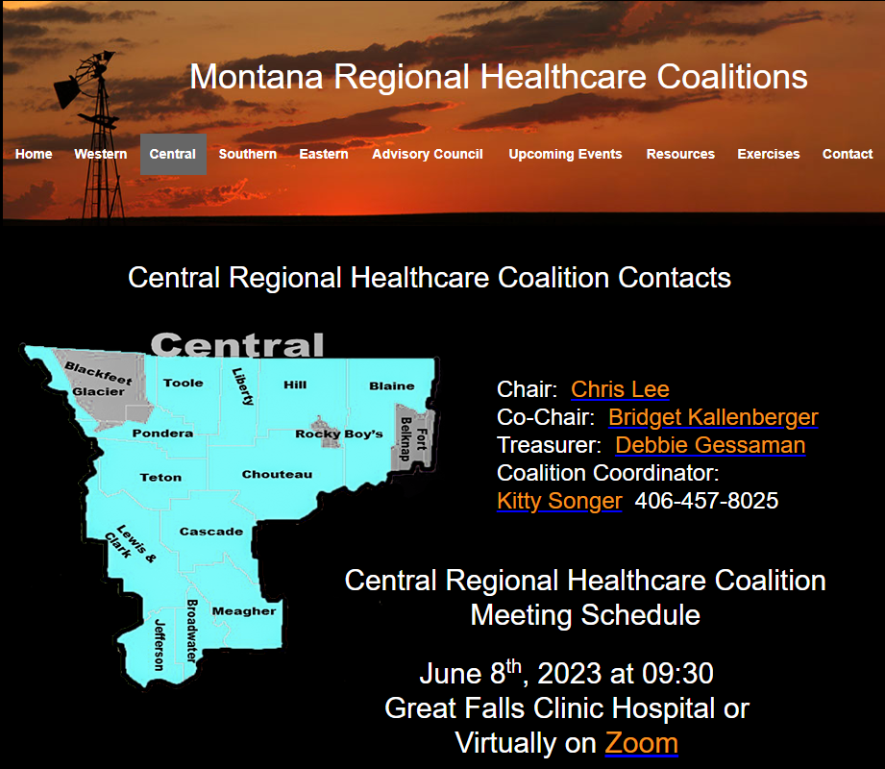

Slide 24
Roundtable discussion… Questions??? Comments Next Meeting? August?

Slide 25
Meeting Adjourned
Needs motion

